Slide 1
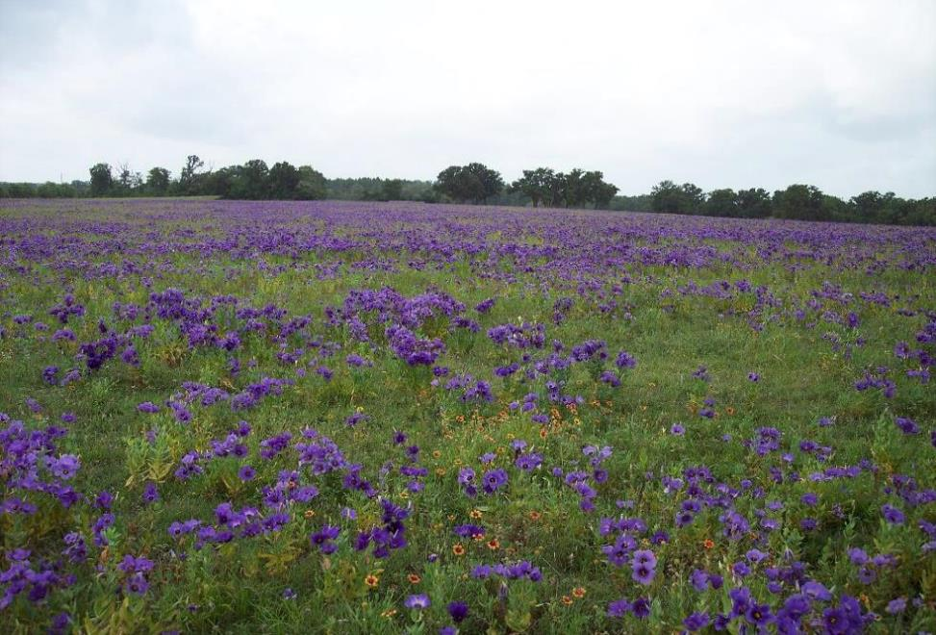
Walker Ranch – Wildflowers
2013-2020
Texas Blue Bells & Indian Blankets

Slide 2
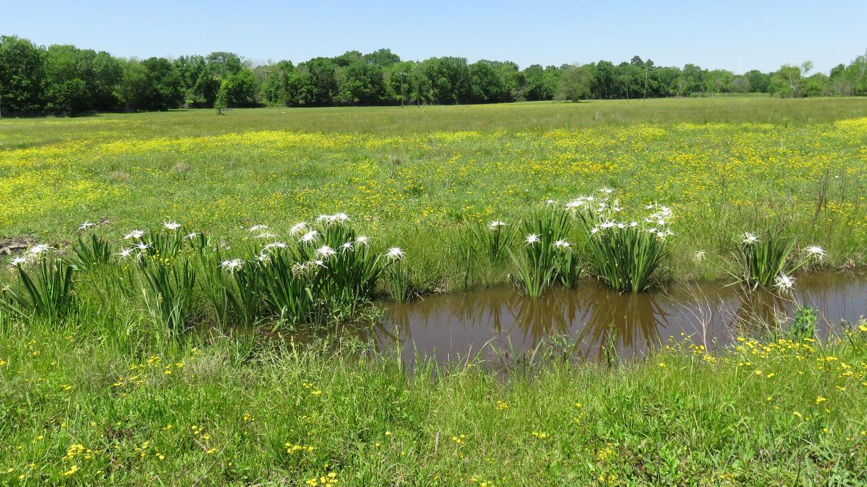
The names on the wildflowers are common names. They were researched and are my best guess. This is a sampling of more than a hundred identified.
Wildflowers show up whenever they want. It’s like a treasure hunt.

Slide 3
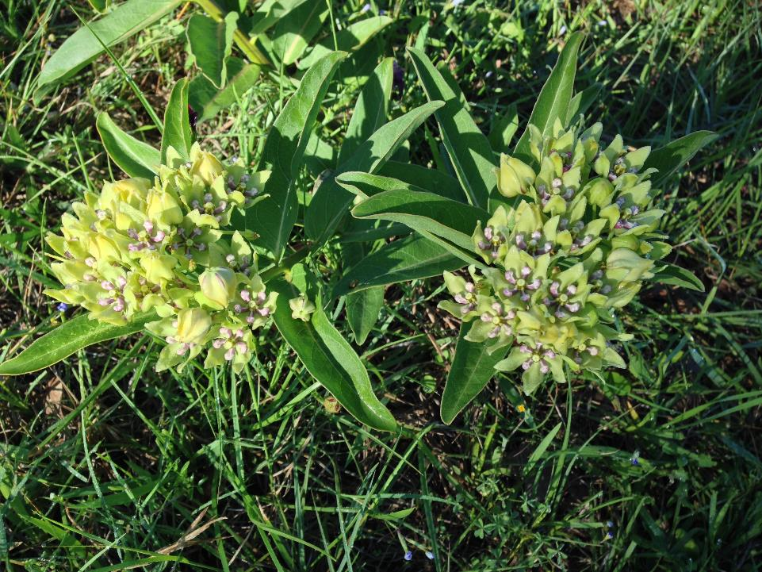
Spider Milkweed (Monarchs’ favorite food)

Slide 4
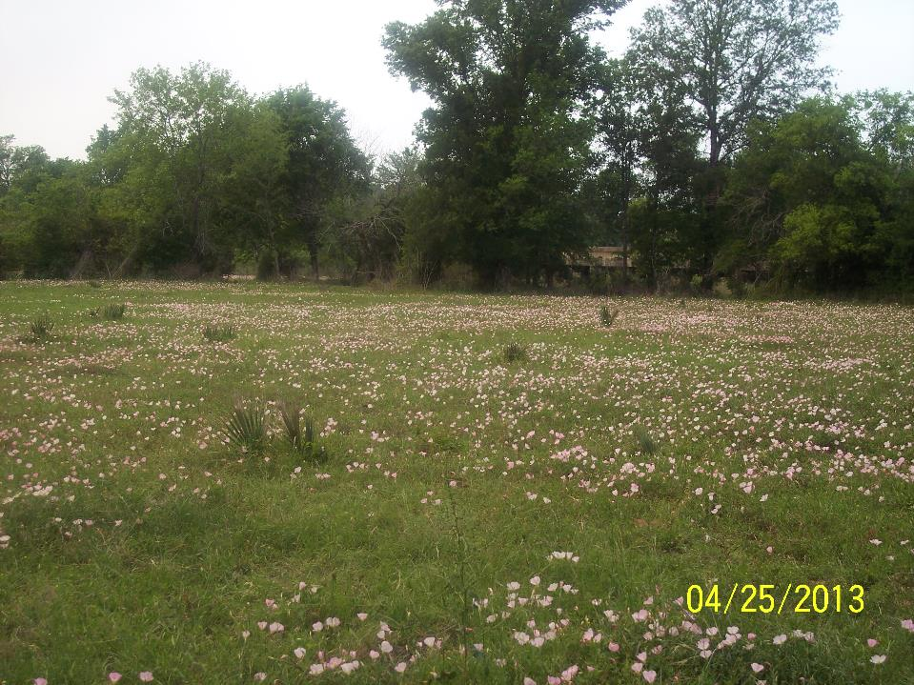
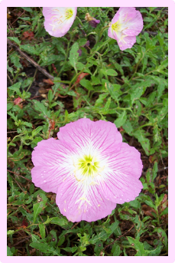
Showy Evening Primrose

Slide 5
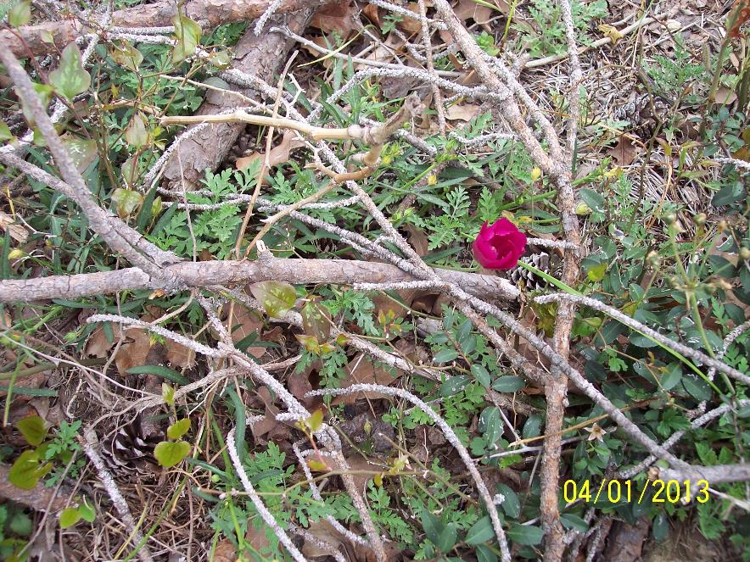
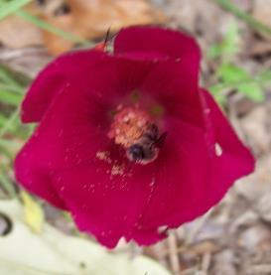
Wine Cup

Slide 6
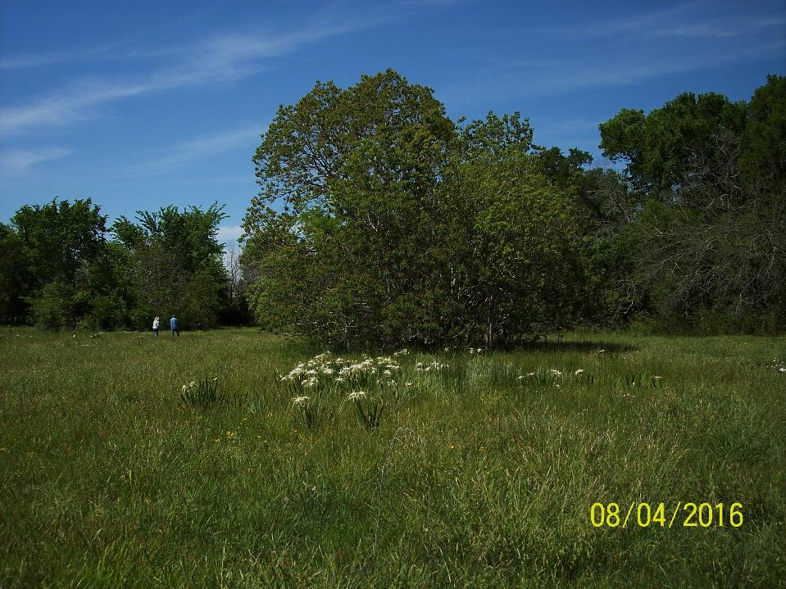
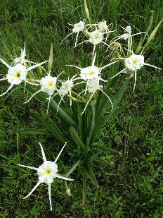
Spider Lilies

Slide 7
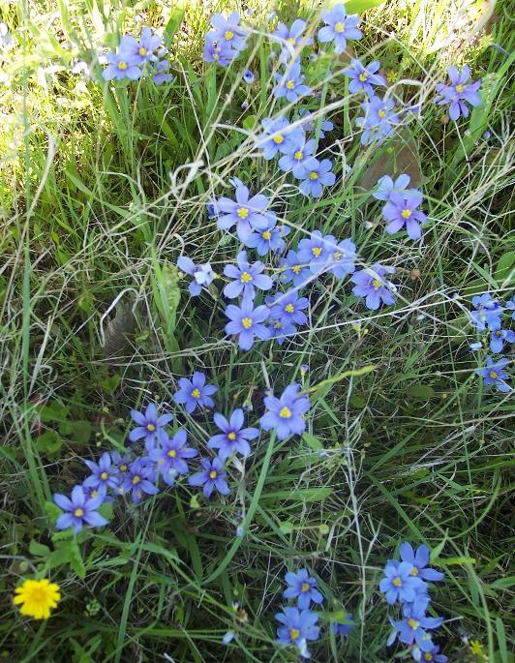
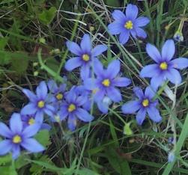
Roadside Blue-Eyed Grass

Slide 8
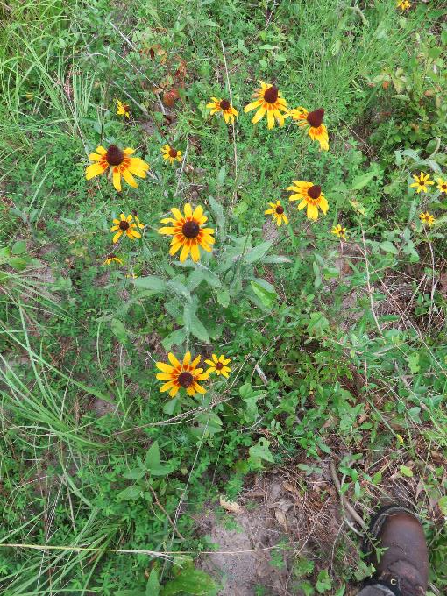
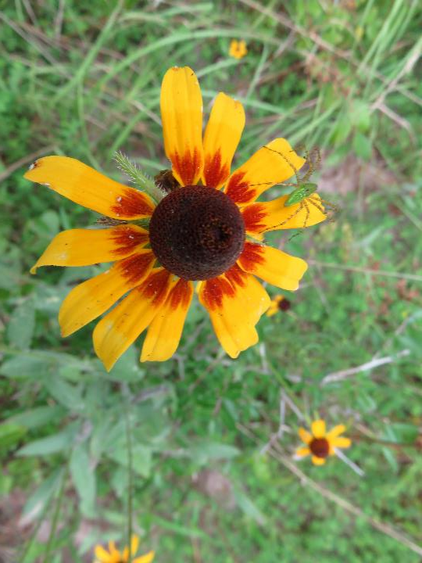
Gloriosa Daisy

Slide 9
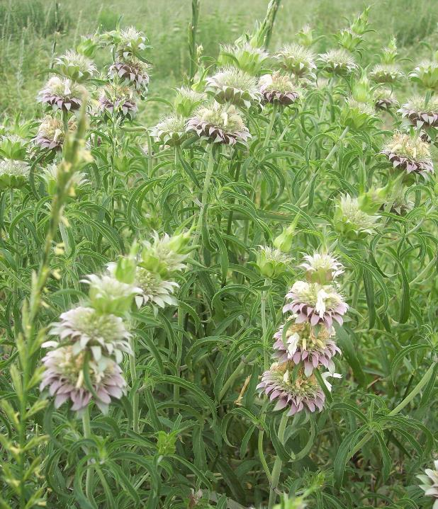
Purple Horse Mint

Slide 10
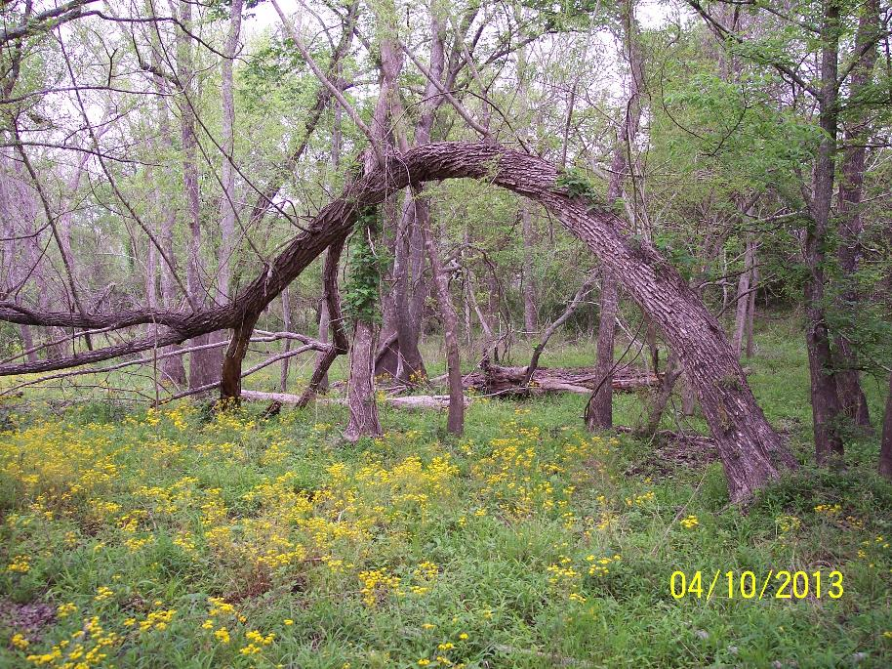
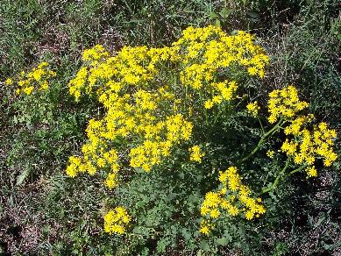
Butterweed

Slide 11
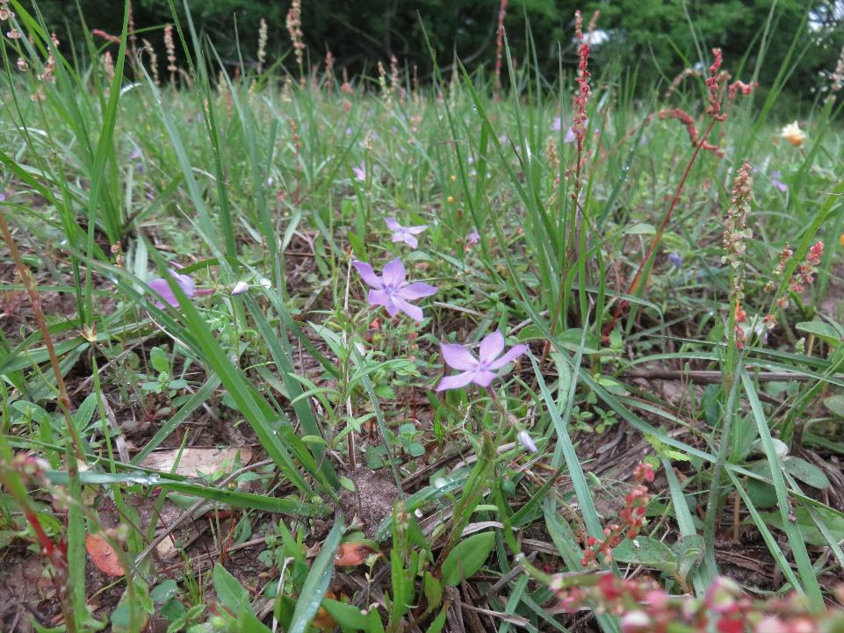
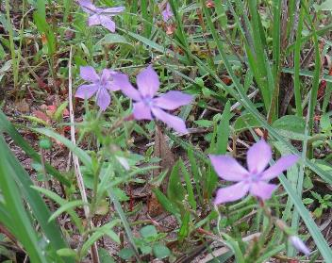
Dwarf Gilia

Slide 12
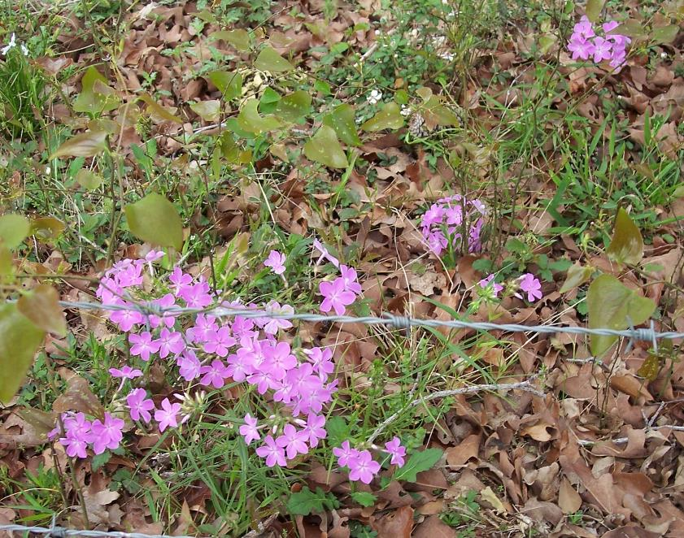
Annual Phlox

Slide 13
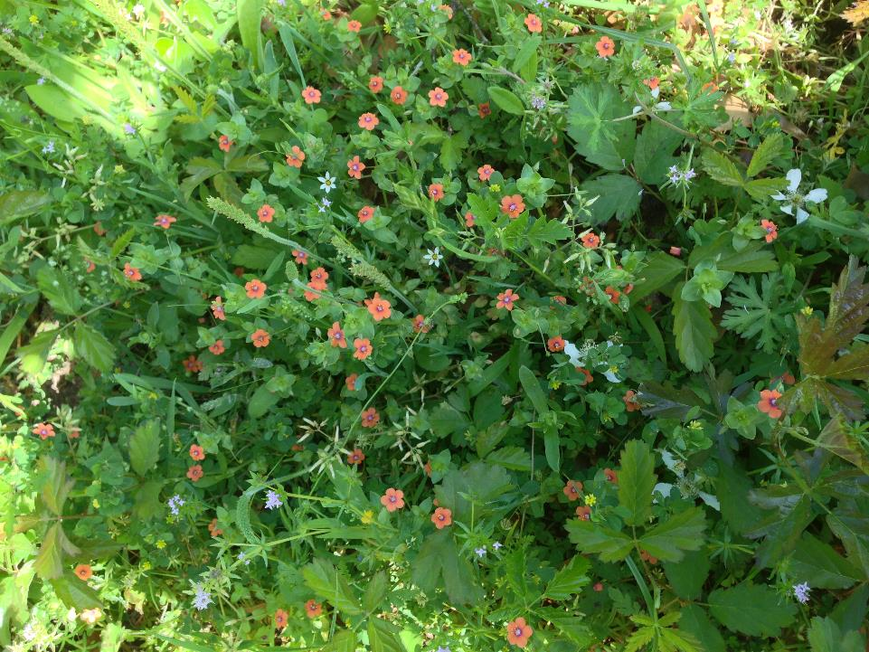
Scarlet Pimpernel

Slide 14
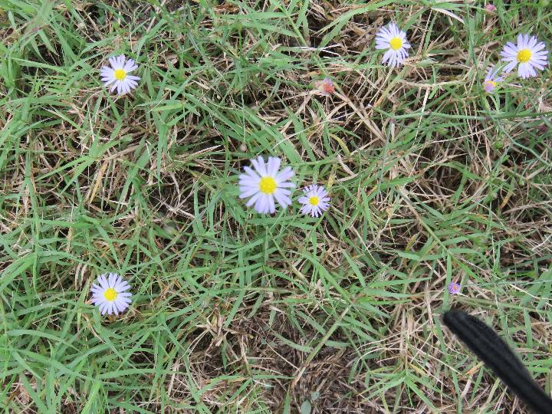
Daisy Fleabane

Slide 15
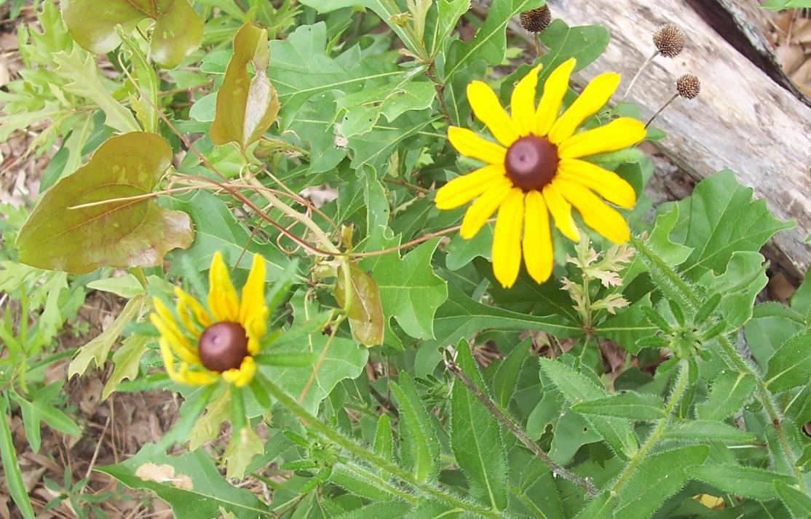
Black-Eyed Susan

Slide 16
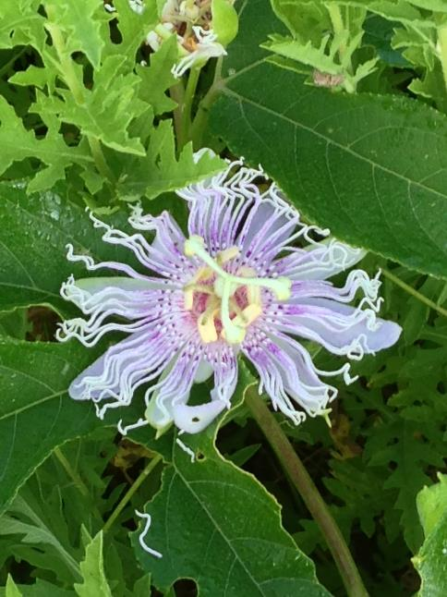
Passion Flower

Slide 17
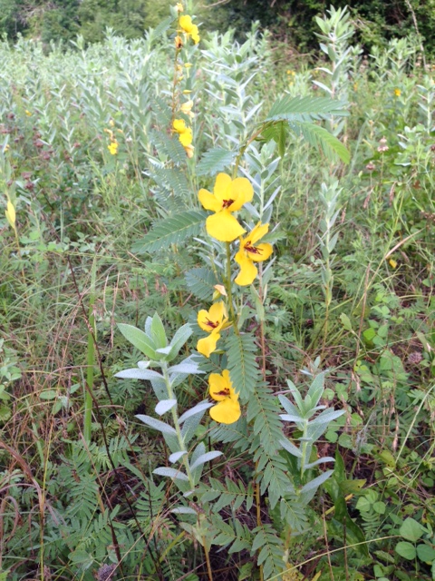
Partridge Pea

Slide 18
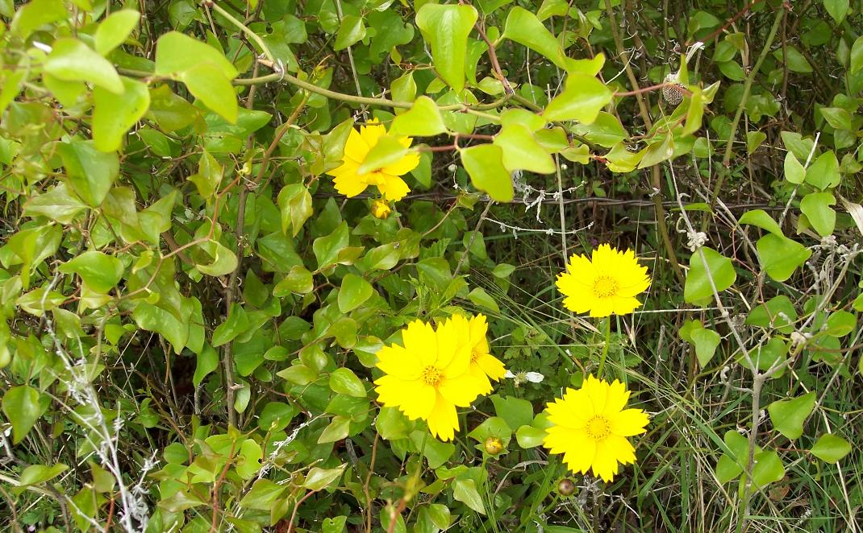
Lance Leaf Coreopsis

Slide 19
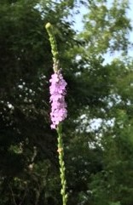
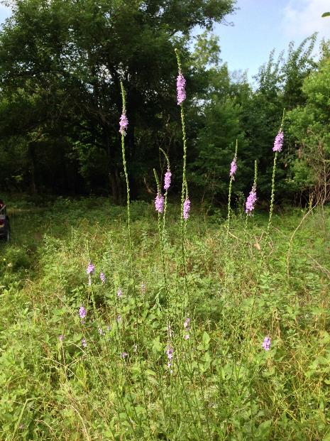
Slender Vervain

Slide 20
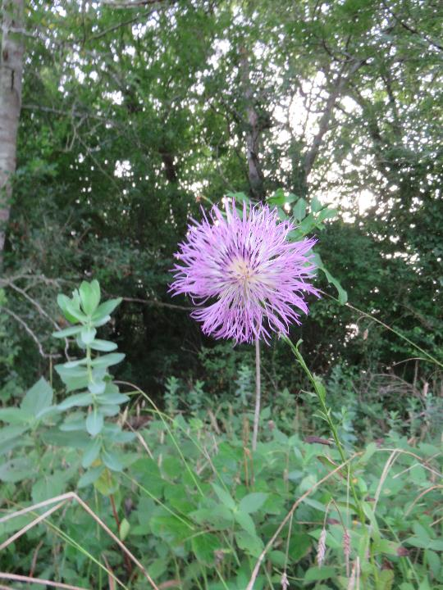
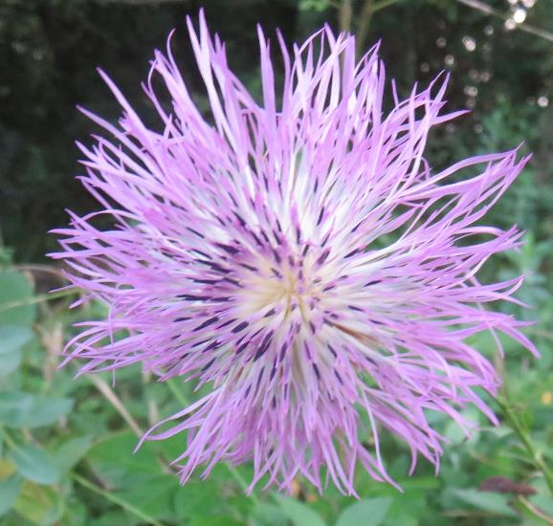
American Basket Flower

Slide 21
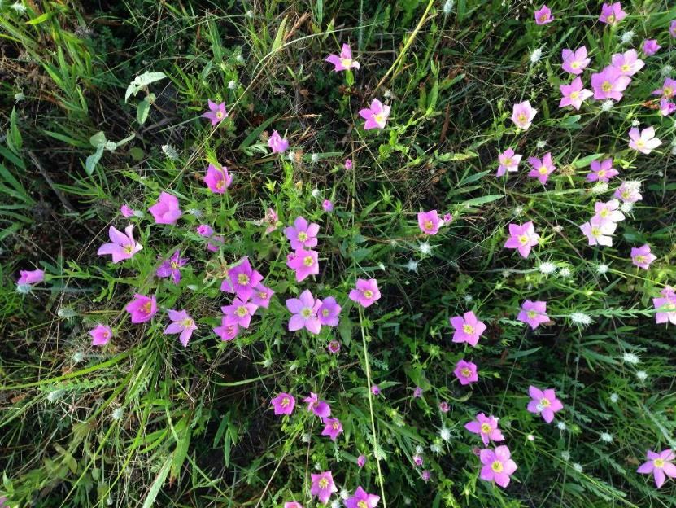
Texas Star or Rose Gentian

Slide 22
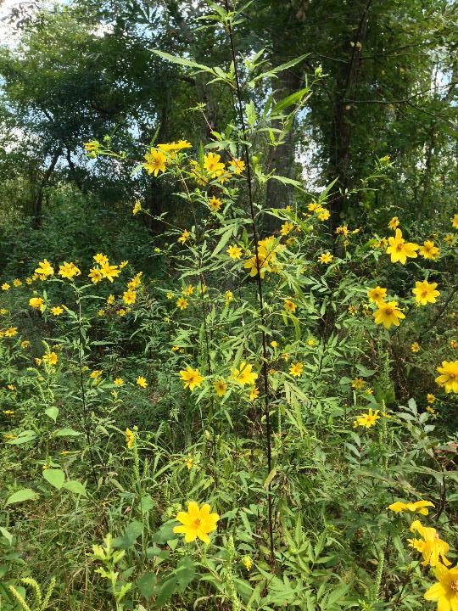
Bearded Beggarticks or Tickseed Sunflower

Slide 23
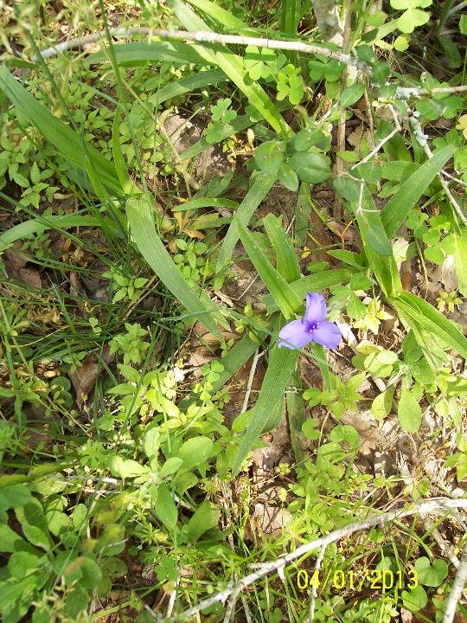
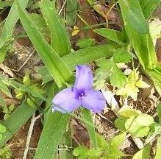
Prairie Spiderwort

Slide 24
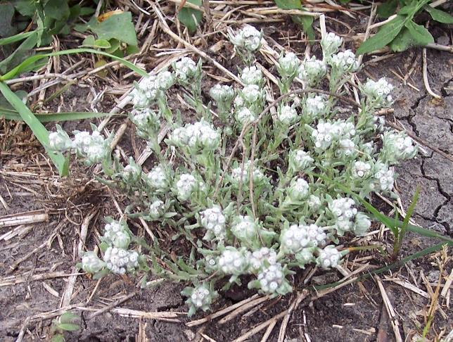
Boneset ?

Slide 25
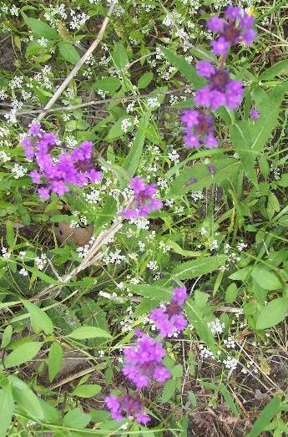
Verbena

Slide 26
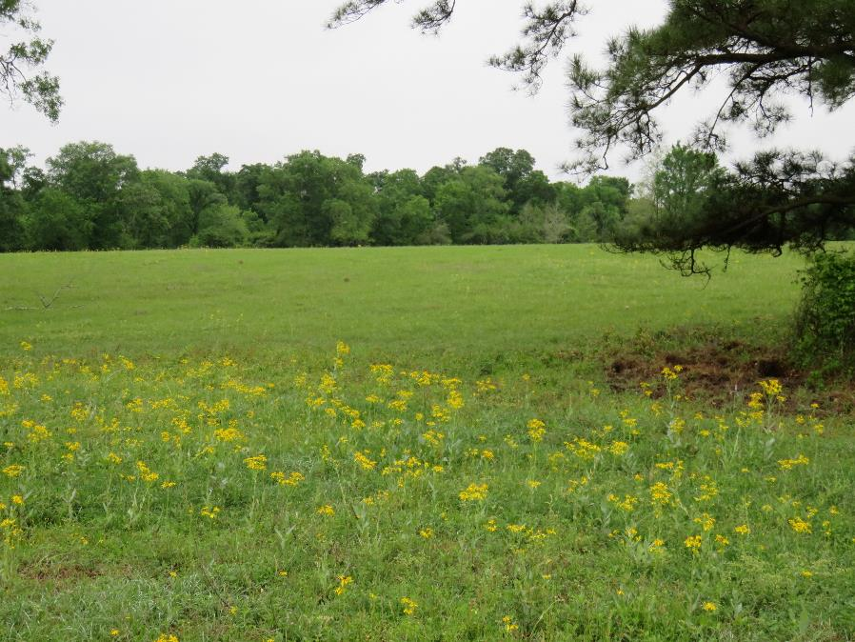
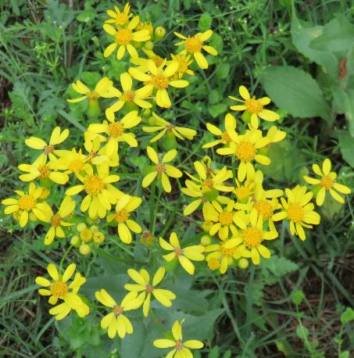
West Ragweed

Slide 27
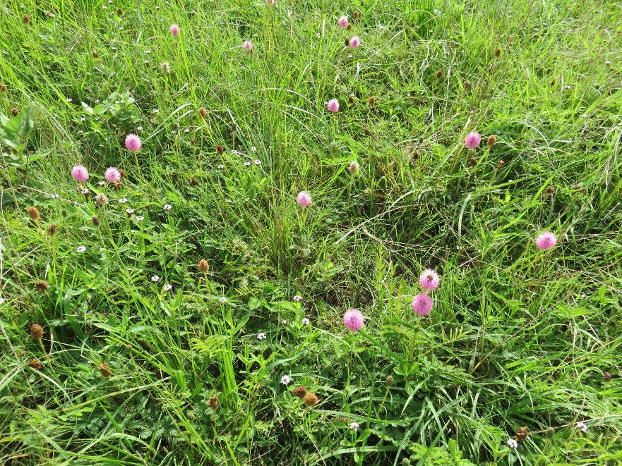
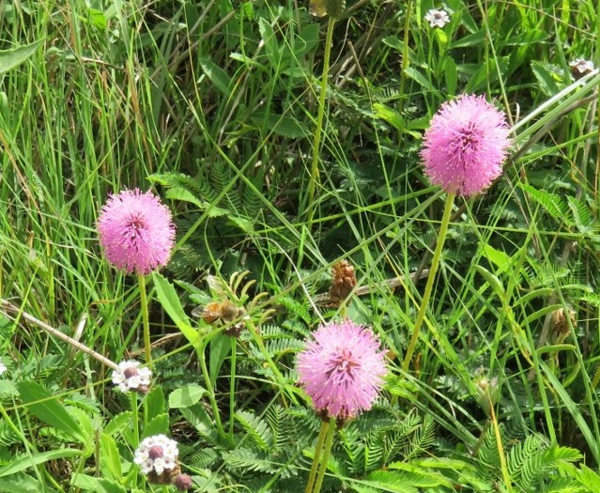
Pink Sensitive Briar

Slide 28
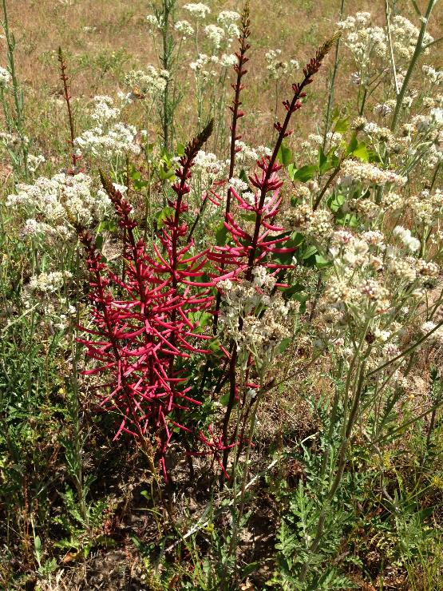
Coral Bean

Slide 29
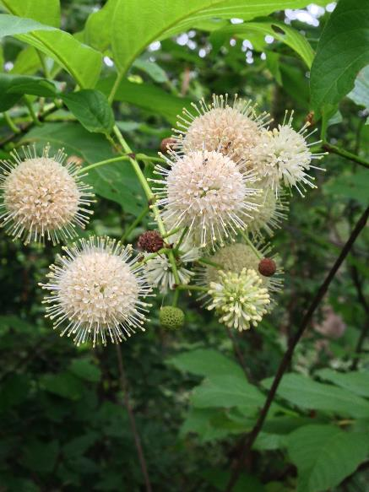
Buttonbush

Slide 30
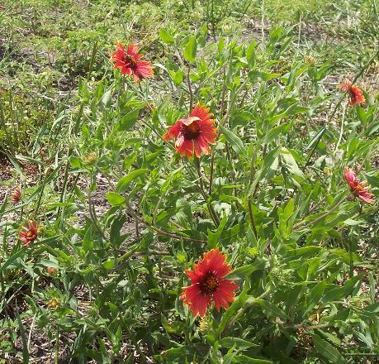
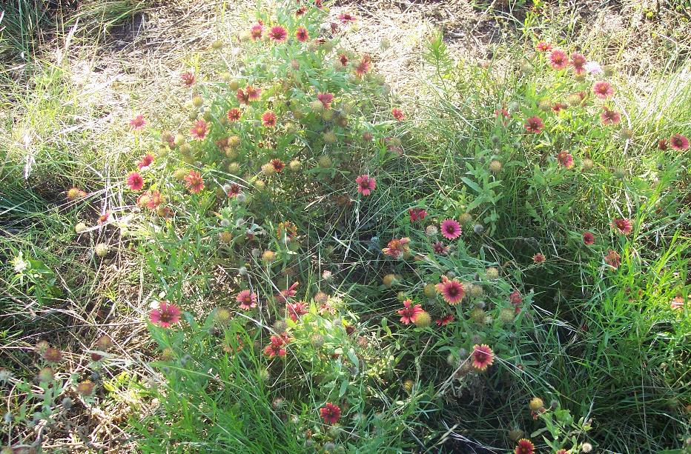
Indian Blanket

Slide 31
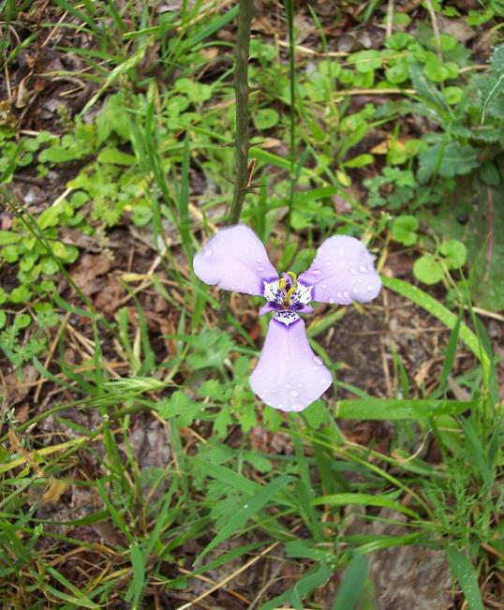
Prairie Nymph

Slide 32
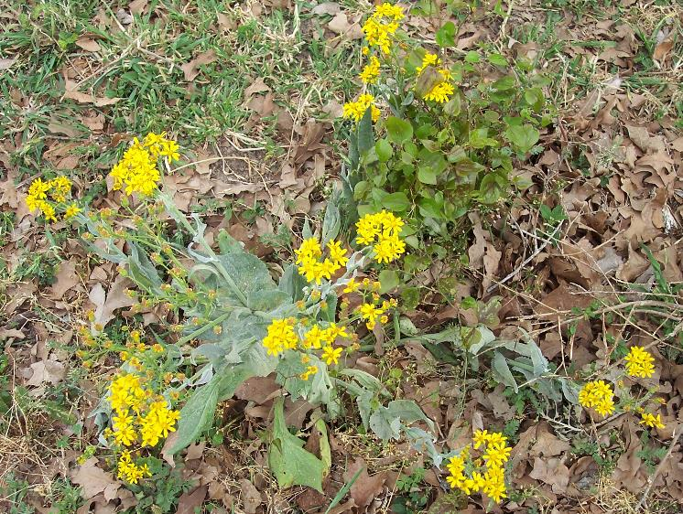
Texas Ragwort

Slide 33
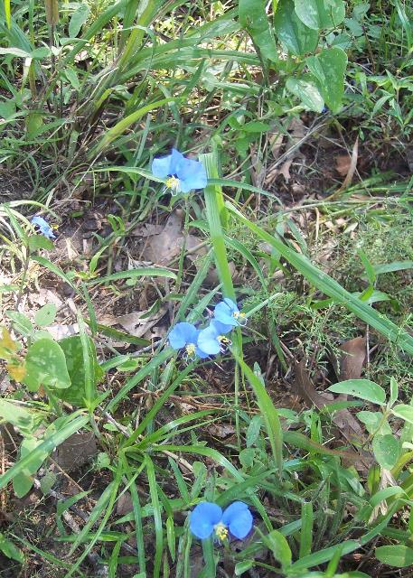
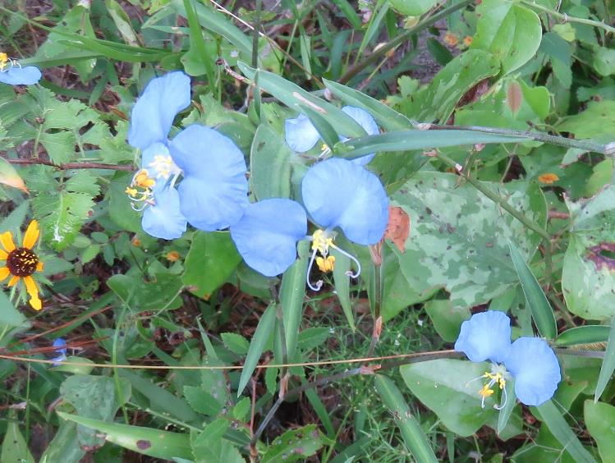
Mouse Ears

Slide 34
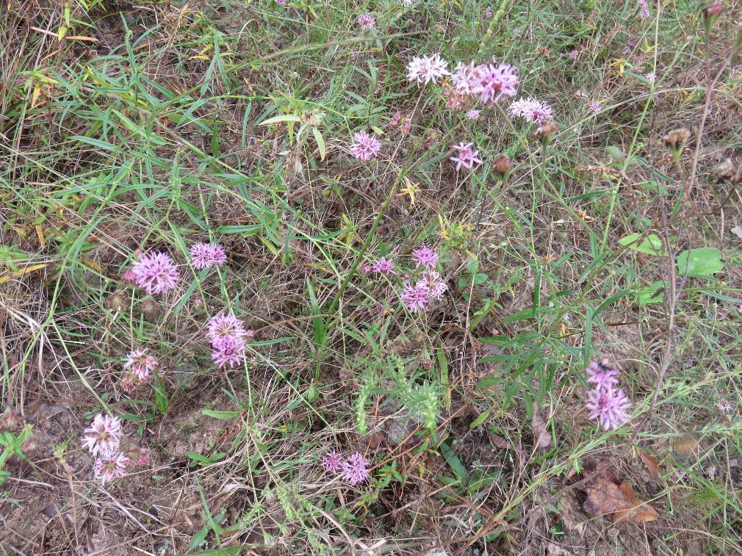
Rosy Palafox

Slide 35
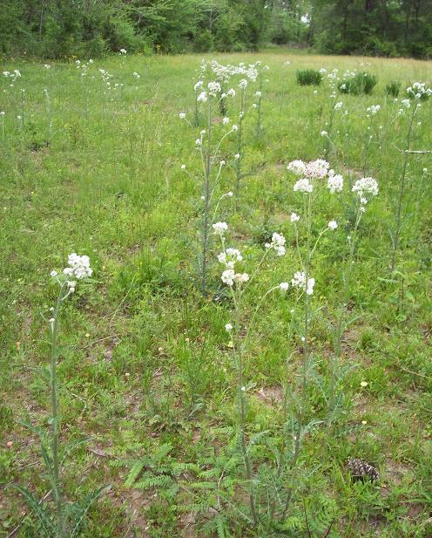
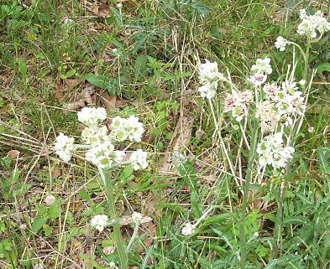
Old Plainsman

Slide 36
Desert Rhubarb

Slide 37
Texas Blue Bonnets and Indian Paint Brush

Slide 38
Buffalo Bur

Slide 39
Wild Bergamot

Slide 40
Bull Thistle

Slide 41
Buck Eye Blooms & Pods

Slide 42
Purple Leather Flower

Slide 43
Texas Beauty Berry

Slide 44
Indian Paint Brush

Slide 45
Common Sunflower

Slide 46
Drummond Wood Sorrel

Slide 47
Queen Ann’s Lace

Slide 48
Meadow Astor

Slide 49
Longbract Wild Indigo

Slide 50
Coral Honeysuckle

Slide 51
Cardinalflower

Slide 52
Foxglove Beardtongue

Slide 53
Indian Plantane

Slide 54
Heart-of-the-earth or Heal-all

Slide 55
Dwarf Iris

Slide 56
Purple Prairie Clover

Slide 57
Golden Wave

Slide 58
Gulf Vervain

Slide 59
Hooker’s Eryngo

Slide 60
Wild Petunia

Slide 61
Toad Flax

Slide 62
Soft Rush

Slide 63
Indian Heliotrope

Slide 64
A Trilogy:
Spider Milkweed
Showy Evening Primrose
Scarlet Pimpernel

Slide 65
The End

